Slide 1
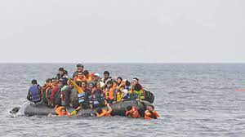
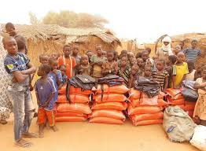
Refugees Knowledge Organiser Y5-6 Term 3
Links to Other Subjects
Geography: Human Geography including land use, economic activity including trade links, and the distribution of natural resources, food, minerals, and water. Science: Properties and Changes of Materials- Compare and group together everyday materials on the basis of their properties, including their hardness, solubility, transparency, conductivity (electrical and thermal), and response to magnets. Best material for refuge shelter.
Key Vocabulary
Refugee – A person who flees their home due to war or natural disaster.
Asylum Seeker – A refugee becomes an asylum seeker when they are granted residency in the country.
Empathy – Thinking about and understanding how other people feel.
Key Knowledge
PSHE To build empathy. To learn how to listen to other’s experiences. To relate others experiences to their own. Consider and learn the different reasons why people leave their home. Lean to empathise with people who must flee their homes. Make decisions and understand how others might feel. To think about ways in which they can support refugees. Discuss what terms like ‘refugee’ and ‘asylum seeker’ means Identify how fleeing your home might impact your life. Examine the difficult choices people have to make and decide what you would do. To understand the governments rules and regulations for refugees and asylum seekers. To understand the role different charities play in providing aid to refugees.
Prior Learning | Preparing for the Future
Y 3-4 Different groups and communities, e.g refugees and asylum seekers Understand that, sometimes, assumptions of people are based on what they look like. Different perspectives – listening and responding to a wide range of people; caring about other people’s feelings. Everyday things that affect feelings and the importance of expressing feelings. British values – rules and laws | KS3 How stereotypes, in particular stereotypes based on sex, gender, race, religion, sexual orientation or disability, can cause damage (e.g. how they might normalise non-consensual behaviour or encourage prejudice). That in school and in wider society they can expect to be treated with respect by others, and that in turn they should show due respect to others, including people in positions of authority and due tolerance of other people’s beliefs.

