Slide 1
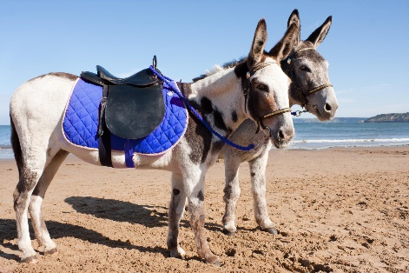
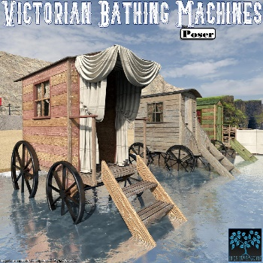
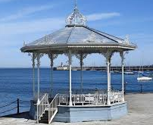
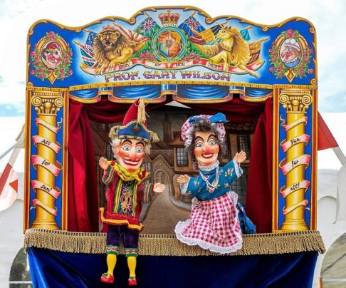
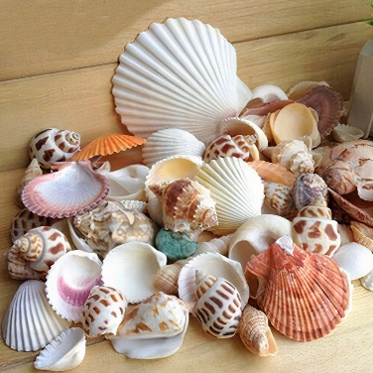
The Seaside Knowledge Organiser Y1-2 Term 6
Links to Other Subjects
Geography In the United Kingdom no one lives more than 130km from the sea. Weymouth was the first seaside resort in Britain and was established over 200 years ago. Coasts have many different features, such as caves, cliffs and beaches. Be able to name some famous seaside towns Padstow, Bournemouth, Blackpool, Brighton Weymouth and Tenby.
Key Knowledge
History To understand that there are differences between seaside holidays 100 years ago, 50 years ago and today. e.g. different clothes, different entertainment. People got changed in special bathing machines. To know that women would use bathing machines to change into their swimming costume. In the past people would be covered and wear their clothes to the beach. They did not have shorts or T-shirts to wear. Not many people sunbathed. Buckets and Spades would be very heavy to carry. They were made from metal, tin and wood. Donkey rides, Punch and Judy and Carousels existed 100 years ago and still exist today. In the past holidays to the sea were nearly always health related, seawater was considered to have a beneficial effect on health and cure disease, The Railways developed so more people began to travel further and visit seaside resorts.
Key Vocabulary
Resort: A popular place for holidays.
Seaside: A place by the sea with a beach and access to the sea.
Beach: Pebble or sandy shore between the sea and the land.
Pier: A wooden structure going from the land and out over the water.
Promenade: A walk way usually along the sea front.
Beach Hut: Is a small wooden hut that is found close to the beach, to shelter from the rain/wind/sun and get changed in and to eat or drink in.
Physical Feature: A feature that has been formed by nature.
Human feature: A feature that has been made or changed by humans.
Bathing machine: These were used a long time ago for people to change in private before getting into the sea.
Bandstand: A covered stand where the band plays.
Amusement arcade: An indoor area with coin operated machines.
Prior Learning | Preparing for the Future
Know the four countries of the united Kingdom. Know that things change over time. Know people go to the Seaside on Holiday, some people live in Seaside towns. Understand that life today is different from life in the past. EYFS To build understanding through historical role play scenarios, memory boxes, historical stories and personal experiences. EYFS To understand the concept of before and after. | A local history study and the development of Oxford City. (Yr 3/4) Describe events from the past using dates when things happen. Say how items belonging in the past are helping us to build an accurate picture of how people lived in the past. Explain how events form the past have shaped our lives today.

