Slide 1
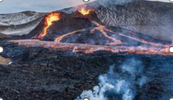
Rocks and Rumbles Knowledge Organiser Y3-4 Term 2
Links to Other Subjects
Design and Technology Reading Writing Science Rocks
To explain how volcanoes are formed and how they affect people’s lives. | To explain what causes earthquakes. | To know types of settlement and land-use. | To explore the impact of our extreme earth on our lives. | To draw conclusions; including diagrams and key geographical vocabulary.
Volcano
Tectonic plates
Eruption
Magma
Crater
Magma chamber
Lava
Urban
Rural
Tsunami
Prior Learning | Preparing for the Future
Year 4 Topics covered: Settlements and Land Use The World Year 3 Topics Covered: The Great Explorer

