Slide 1
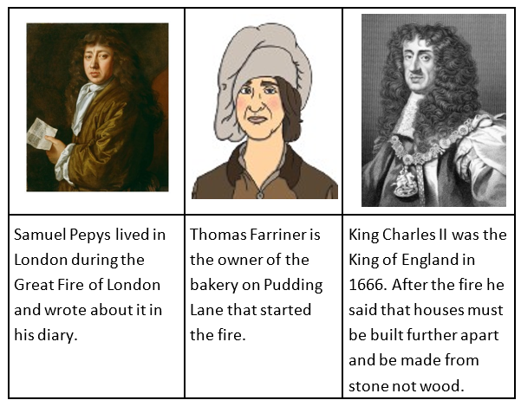
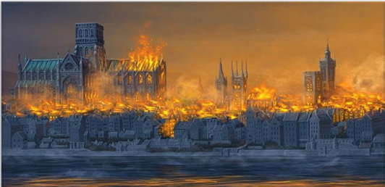
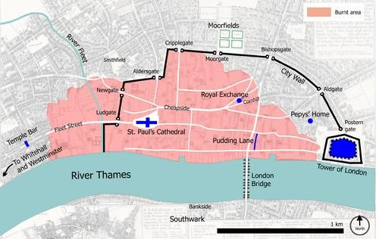
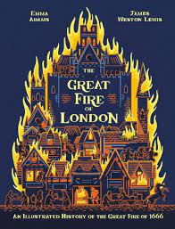
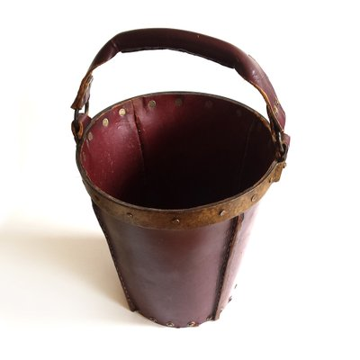
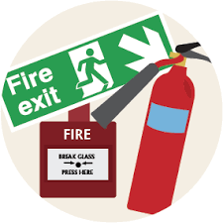
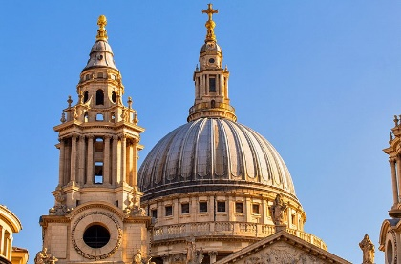
The Great Fire of London Knowledge Organiser Y1&2 Term 3
Key People
Key Knowledge
History The fire started on Sunday 2nd September 1666, in Thomas Farriner’s bakery on Pudding Lane. It started because fires in the ovens had not been properly put out. In 1666 in London the building were made of wood and straw and they were very close together which made it easy for fire to spread. People used leather buckets and water squirts to put the fire out but these did not work. King Charles II ordered buildings to be pulled down to stop fire spreading. The fire was out by 6th September 1666. The disaster made London a better and safer city, streets were widened and buildings were made stronger, more fireproof and made from brick. Today we have firefighters who have protective equipment, fire engines and powerful hoses. There can be more than one reason leading to an important historical event taking place. Gathering reliable evidence helps us suggest what might of actually happened in the past.
Key Vocabulary
History
Bakery: a shop where bread is made.
Gunpowder: explosive powder used to blow up buildings.
Thatched roof: dried straw tied tightly together and laid on the roof of a building.
Wattle and daub: animal waste, straw and mud used to make walls of buildings.
Flammable: something that catches fire
Embers: burning remains of a fire.
Cathedral: the main church of a diocese that
has a bishop.
London: the capital city of England.
Rebuilt: when we repair something that has been lost or damaged.
Monument: a structure to help people remember.
The Thames: the river running through London.
King: a man who rules a country.
Architect: a person who plans and builds buildings.
Source: shows information about the past.
Diary: a personal record of life’s events.
Prior Learning | Preparing for the Future
History Know events happened in the past a long time ago. Know some similarities and differences between things in the past and now, drawing on experiences. Understand the past through stories and books. | History Develop a chronologically secure knowledge and understanding of British, local and world history. Note connections, contrasts and trends over time and develop the appropriate use of historical terms. Devise historically valid questions about change, cause, similarity and difference, and significance.

