Slide 1
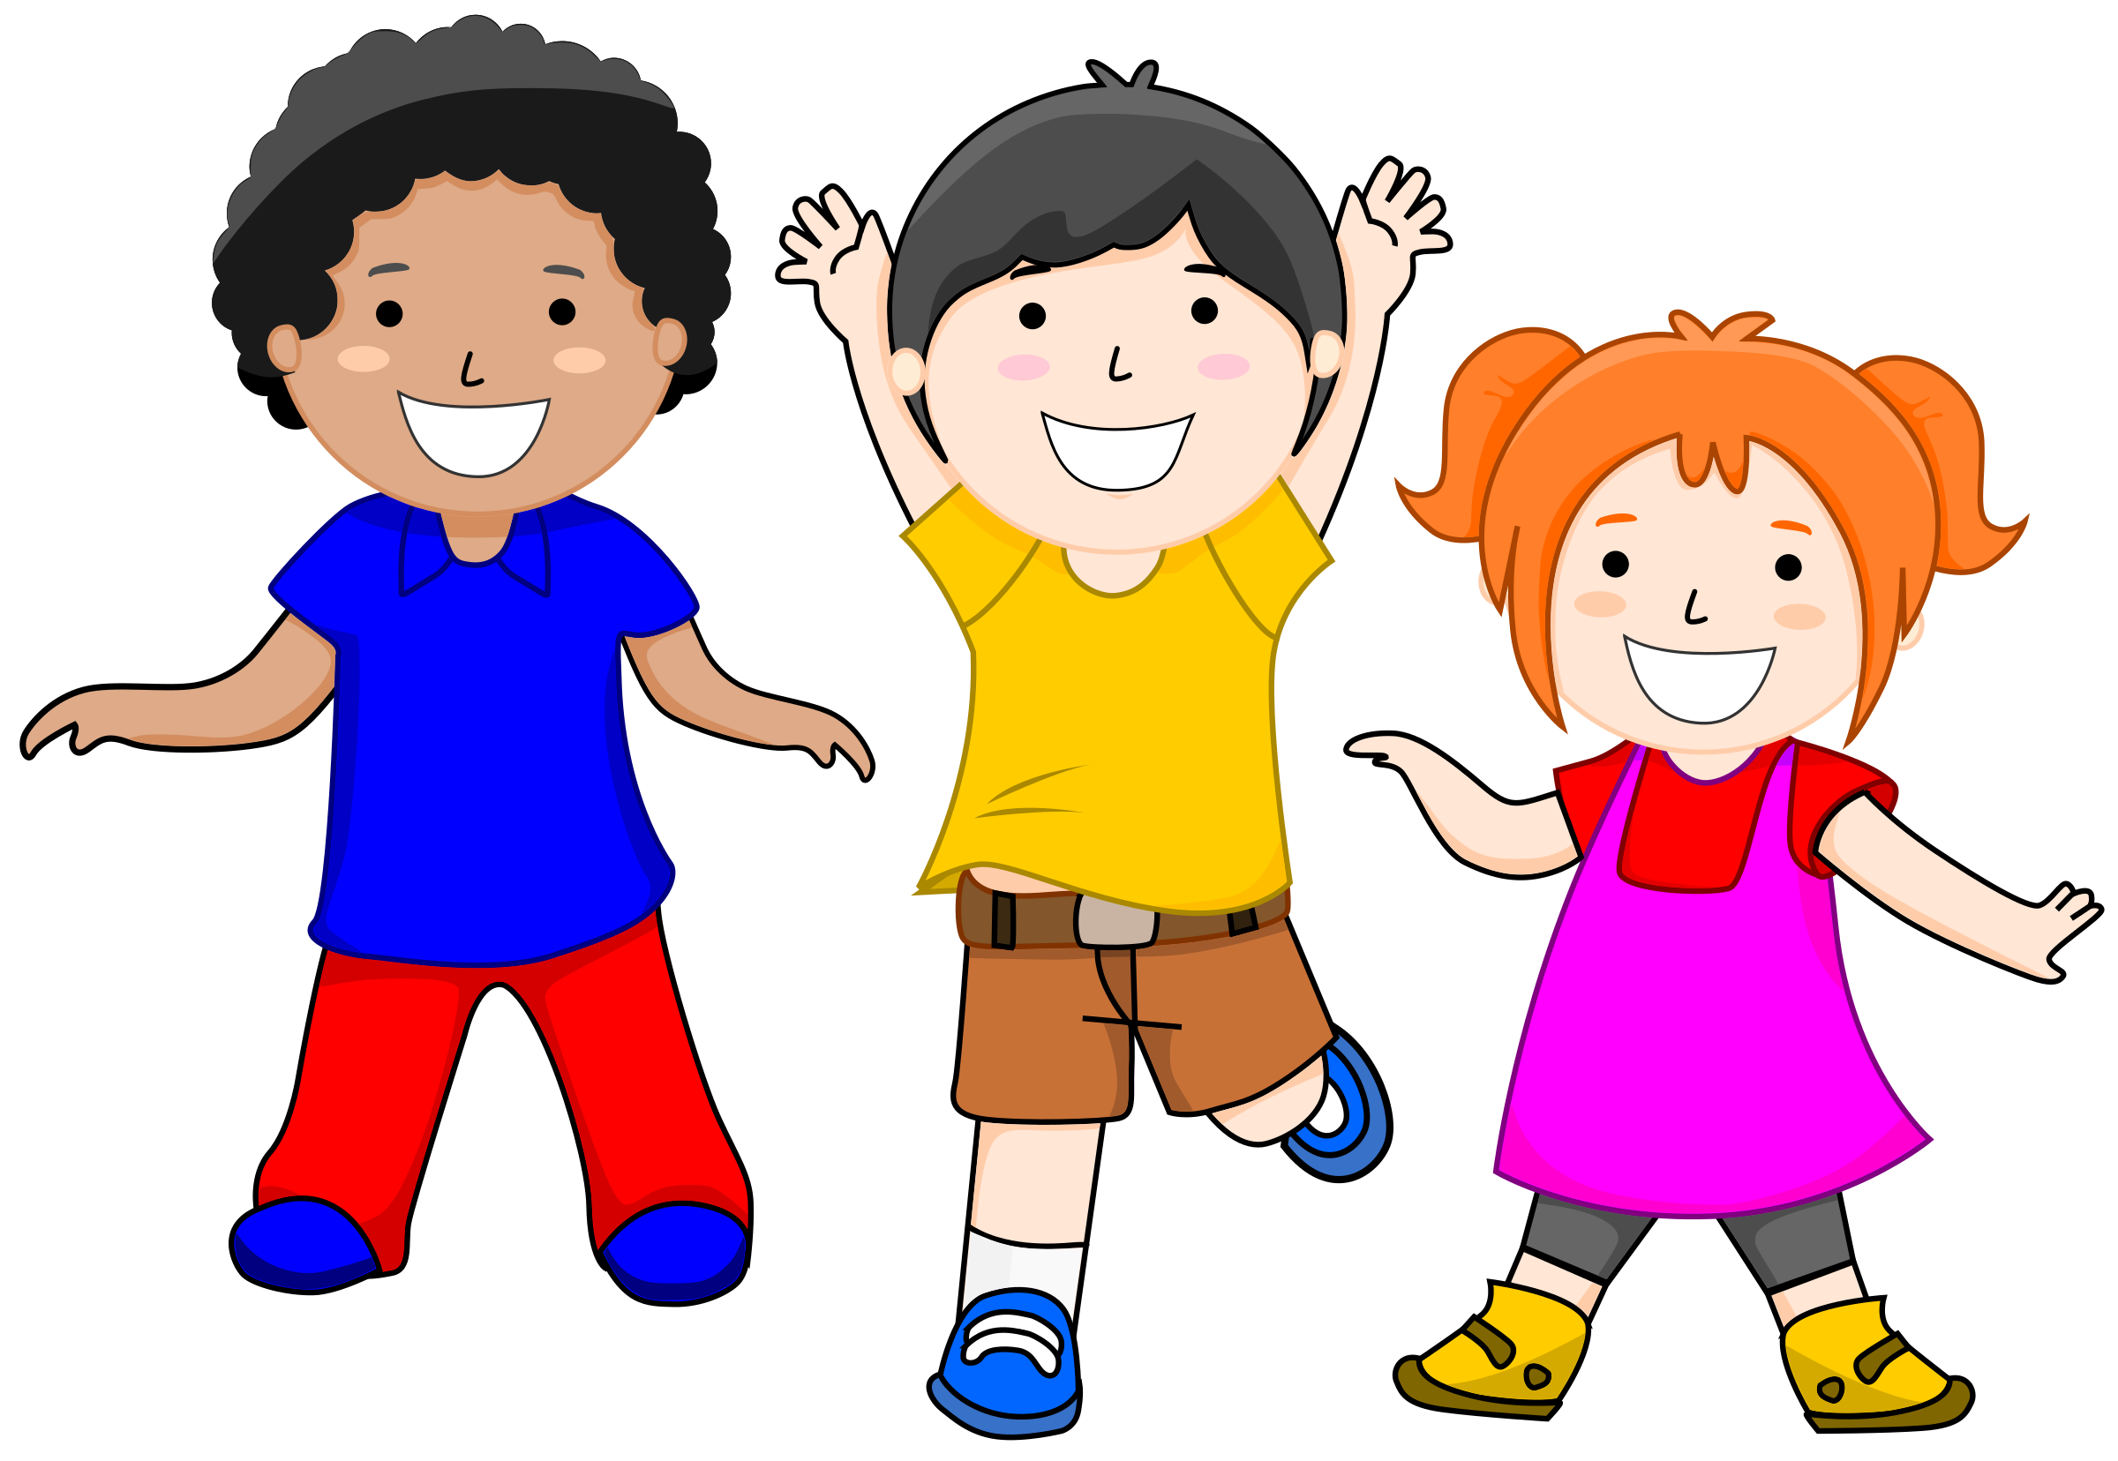
Me and My Feelings- Knowledge Organiser – EYFS Term 2
Links to Other Subjects
UTW: How we feel and how we manage our feelings Art: Christmas art RE: Diwali Cooking; feeling biscuits
Key Vocabulary
Feelings​
Emotions​
Happy​
Sad​
Confused​
Worried​
Angry​
Frustrated ​
Facial expressions​
Moods​
Friendships​
Help and support
Key Knowledge
Explore the differences between us Explore our feelings and how to express them Use various materials to express our feelings Know some similarities and differences between different cultural events e.g. Diwali, Guy Fawkes, Christmas Explore the natural world around them and making observations → Stars & rainbows Explore colours around us Engage in non-fiction and fiction books about feelings Describe what they see
Prior Learning | Preparing for the Future
Develop play around favourite stories using props Explore natural materials with different properties Explore and respond to different feelings and emotions | Participate in small group, class and one-to-one discussions, offering their own ideas Observing closely, using simple equipment asking simple questions and recognising that they can be answered in different ways observe and describe feelings and emotions

