Slide 1
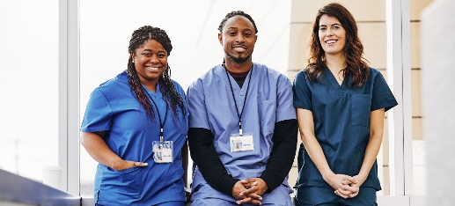
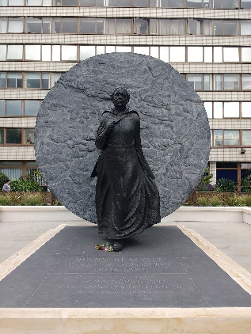
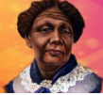
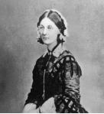
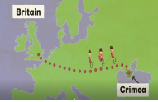
Great women pioneers Mary Seacole and Florence Nightingale Knowledge Organiser Y1&2 Term 4
Key People
Mary Seacole, born in Jamaica in 1805. Florence Nightingale, born in Italy in 1820 moved to England as a baby.
Key Knowledge
History Florence Nightingale and Mary Seacole both went to the Crimean War to nurse soldiers. They both lived in Victorian Times. In 1866 Mary Seacole set off to the Crimea on a ship stocked with medical supplies, the British Government wouldn’t pay for her to go so she used her own money. She opened a “British Hotel” near to the battlefields, soldiers could rest and buy hot food, drinks and equipment. She received medals from governments in different countries. Mary so was caring, she became known amongst the soldiers as “Mother Seacole”. The soldiers called Florence Nightingale ‘The lady with the lamp’ because she walked around the wards at night with a lantern. Florence spent her life trying to make hospitals better places for everybody. The Nightingale Fund was established for the training of nurses at St Thomas’ Hospital London. Florence ‘changed the world’ by changing how sick people were cared for across Britain and the world. She was awarded the Royal Red Cross by Queen Victoria in 1883
Key Vocabulary
History
Victorian times: The time between 1837 and 1901, when Queen Victoria was the queen of England.
The Crimean War: A war between Russia on one side and Britain, France and Turkey on the other.
Soldier: A person who fights in an army.
Frontline: The place where the worst fighting is happening during a war.
Nurse: A person whose job is to care for people who are sick or injured.
Patient: A person who is ill in hospital.
Infection: An illness caused by spreading germs.
Disease: A condition that causes harm to the health of a person, animal or plant.
Hygiene: Keeping things clean.
Health: Keeping your body working at it’s best.
Exercise: An activity requiring physical effort, which makes your heart work harder and maintains health and fitness.
The Red Cross: An organisation that helps those affected by war, flood and disease.
Inspire: Something or someone who makes you want to do something.
Prior Learning | Preparing for the Future
History Know events happened in the past a long time ago. Know some similarities and differences between things in the past and now, drawing on experiences. Understand the past through stories and books. Know about people who help us. | History Develop a chronologically secure knowledge and understanding of British, local and world history. Note connections, contrasts and trends over time and develop the appropriate use of historical terms. Devise historically valid questions about change, cause, similarity and difference, and significance.

Slide 2
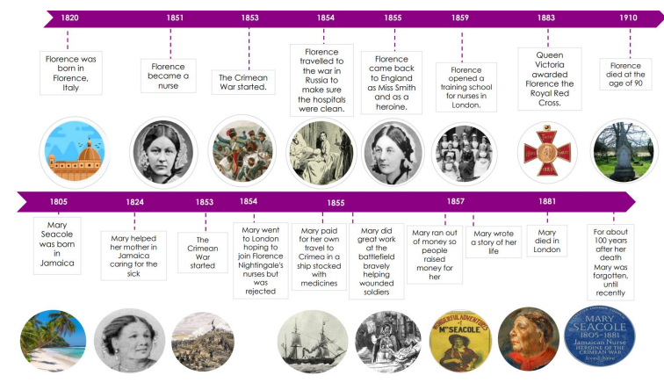
Great women pioneers Mary Seacole and Florence Nightingale Knowledge Organiser Y1&2 Term 4
Why do you think they were treated differently?
Florence Nightingale was from a very wealthy family but Mary Seacole was not.
Mary Seacole was from Jamaica. During this time people from other cultures were not treated with respect.
Florence Nightingale educated herself through reading books whereas Mary Seacole learnt herbal medicines from her mother.
Mary believed in treating all people with equal kindness.
Even though Mary had been known and loved so well her story was lost in history for 100 years. But in the 1980s her story was rediscovered making it possible for generations to come to celebrate and remember her heroism during the Crimean War.

