Slide 1
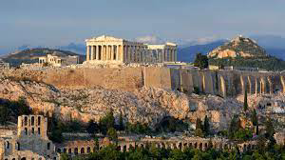
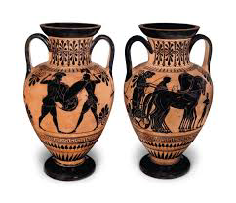
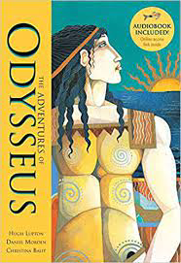
Ancient Greece Knowledge Organiser Y5-6 Term 1
Links to Other Subjects
Art and Design Greek Pots: To explore work from designers, describing the differences and similarities between different practices and disciplines (pottery, sculptures). To understand that a sculpture can be created by the removal of material as well as adding material. Use gouging and scraping techniques. To experiment with clay to make different pots (coil, thumb and slab).
Key Vocabulary
Philosophy – a way of thinking about the world and the universe.
Democracy – allowing citizens to make their own decisions for their personal life
Temple – a building devoted to worshiping a god or goddess
Spartans – They believed a strict upbringing was essential to make an effective soldier
Key Knowledge
Understand that Ancient Greece is known as the ‘birthplace of Western civilisation’. The origins of the first Olympics and the sports they included (boxing, long jump, javelin, discus and chariot racing). The names of the Greek gods and goddesses and their roles. That the Ancient Greeks had different festivals to honour their gods. Most Ancient Greeks wore a chiton, which was a long T-shirt made from one large piece of cotton. The poor slaves, however, had to make do with a loincloth. To compare the features of ancient and modern civilisations. To be able to describe significant battles in Ancient Greek history including the battle of Troy. To be able to explain what life was like as an Athenian and a Spartan (the strict upbringing to become a Spartan warrior). To explain how we can interpret the past using primary (artefacts including pots) and secondary sources of information. To use pottery to interpret what life was like for Ancient Greeks.
Prior Learning | Preparing for the Future
The children will be able to describe and order periods in time using AD, BC and ancient, on a timeline. • To understand that things were different in the past and have changed over time. • To understand how artefacts help us to build a picture of how people lived in the past. | To be able to describe where the Ancient civilisations of the Shang Dynasty and Mayans sits in the chronological timeline. • To understand that the Shang dynasty and the Mayans occurred at the same time in history, but in different continents. KS3: • Know and understand significant aspects of the history of the wider world: the nature of ancient Civilisations; the expansion and dissolution of empires.

