Slide 1
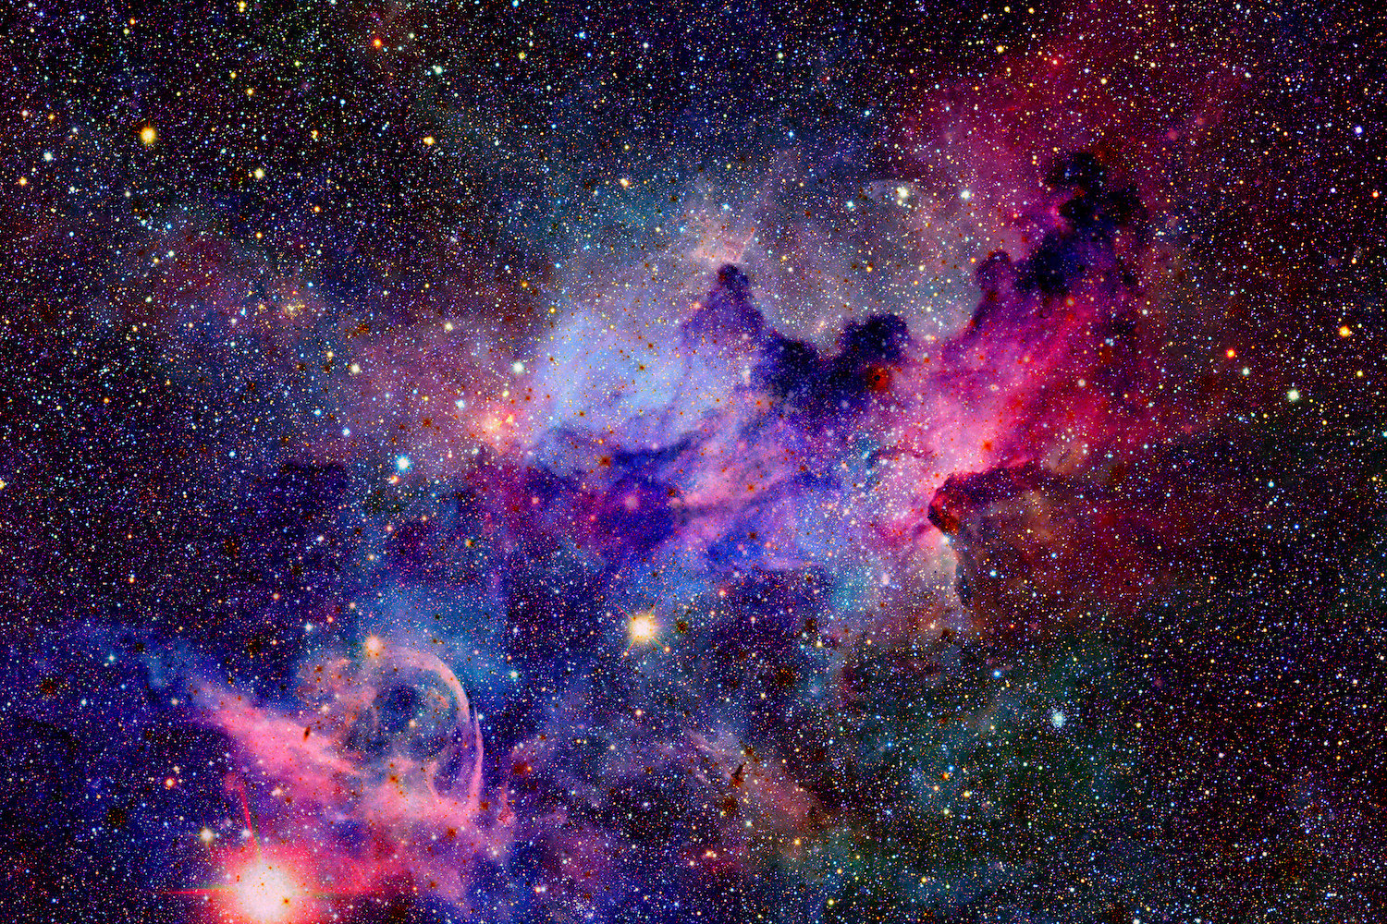
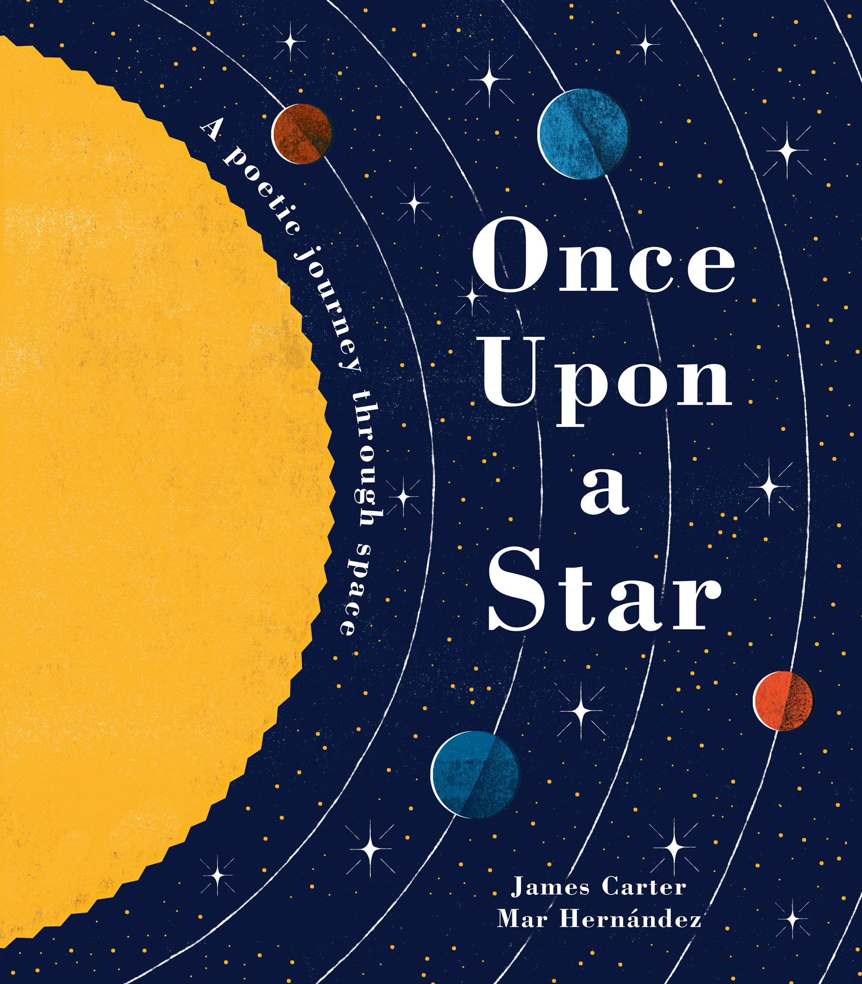
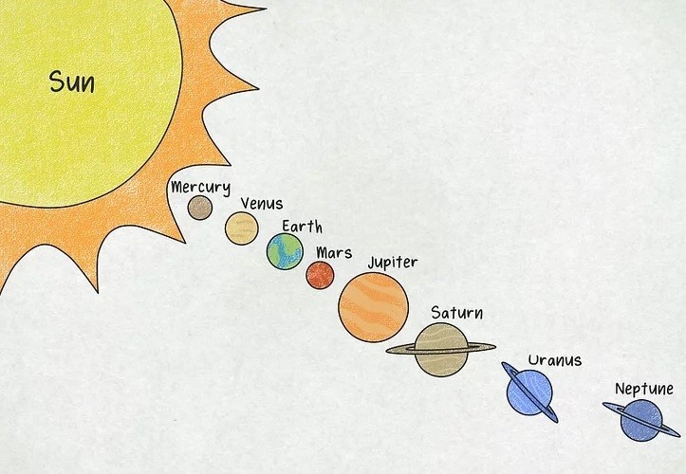
Space - Knowledge Organiser – EYFS Term 3
Links to Other Subjects
Art: Planets in a shoe box C&L: Engage in non-fiction books; Learn songs; PD: Develop ball skills with different sized blow up planets Lit: Write short sentences about space pictures Maths: Count and compare planets UTW: Look at the night sky
Key Vocabulary
Galaxy
Solar System
Astronaut
Comet
Asteroids
Earth
Space
Rocket
Satellite
Sun
Moon
Key Knowledge
C&L: Enjoy listening to longer stories and remembering aspects of the story. C&L: Use a wide range of topic vocabulary during Roleplay. C&L: Sing our Planet song UTW: Learn the planets in our solar system. UTW: Talk about what they see at the night sky. Lit: Engage in extended conversations about topic books. Maths: Say one number for each planet in our solar system. Maths: Make size comparisons between planets
Prior Learning | Preparing for the Future
Explore and respond to different natural phenomena e.g. night and day. Light and dark. Compare amounts and begin to count in everyday contexts. Listen to story and repeat words from a favourite story. | Make comments about what they have heard and ask questions to clarify their understanding. Demonstrate understanding of what has been read to them by retelling stories and narratives using their own words and recently introduced vocabulary.

