Slide 1
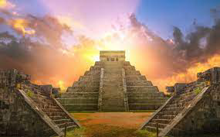
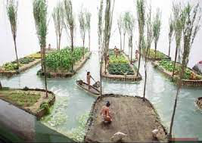
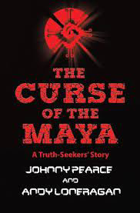
The Mayans Knowledge Organiser Y5-6 Term 5
Links to Other Subjects
Art and Design: Mayan mosaic: Experiment with a range of media to overlap and layer, creating interesting colours and textures and effects. 3D Mayan Masks - Select and use found materials with art media and adhesives to assemble and represent an image or stimulus
Key Vocabulary
civilisation – a human society with well developed rules and government
drought – a long period of time with little or no rain
codices – an ancient text
Scribe – a person trained to write things down
Chichen Itza – A Mayan city with two pyramids
Key Knowledge
To understand that the Mayans used codices. To explain that the Mayans developed an advanced number system and were one of two cultures to developed a symbol for 0. To explain what syllabograms and logograms are. Know that maize and chocolate were important foods and be able to explain how they cultivated them. Explain different ritual elements of the ancient Maya religion (singing, dance, sacrifices, offerings) and describe some of the main gods in greater detail (Kukulkan). The Mayans believed their priests could communicate directly with the Gods. To understand that the Mayans believed in three worlds: the upper world, where the Gods lived; the middle word, where they lived – they thought was flat and the underworld where you went after death. They believed they were all connected by a tree. Describe the different features of Maya cities(pyramids in Chichen Itza, floating gardens) and be able to appreciate what it would have been like to live there.
Prior Learning | Preparing for the Future
The children will be able to describe and order periods in time using AD, BC and ancient, on a timeline. To understand that things were different in the past and have changed over time. To understand how artefacts help us to build a picture of how people lived in the past. | To be able to describe where the Shang Dynasty sits in the chronological timeline. To understand that the Shang dynasty and the Mayans occurred at the same time in history, but in different continents. KS3: Know and understand significant aspects of the history of the wider world: the nature of ancient civilisations; the expansion and dissolution of empires.

