Slide 1
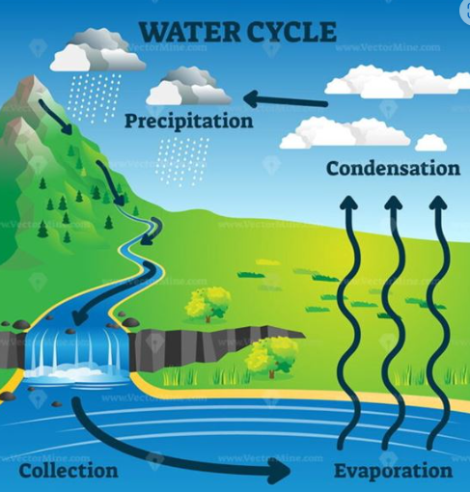
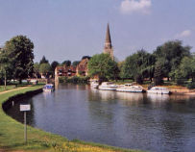
Rivers and The Water Cycle
Prior Learning:
Continents and oceans
Weather
The Rainforest
The Water Cycle
The UK
Local land use
Key Vocabulary
Precipitation
Evaporate
Condensation
Tributaries
Meander
Stream
Estuary
Geography
To know the the formation and features of rivers
To describe aspects of physical geography
To explore types of land use
To understand why people choose to settle near rivers.
To explore the stages of the water cycle.
Science
To know the part played by evaporation and condensation in the water cycle.
To explore the association between evaporation and temperature.
To learn the stages of the water cycle and how rain is formed.

