Slide 1
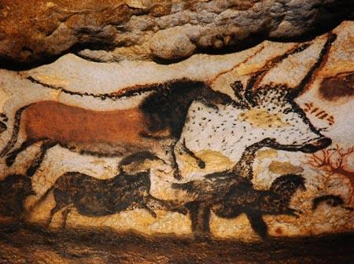
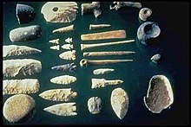
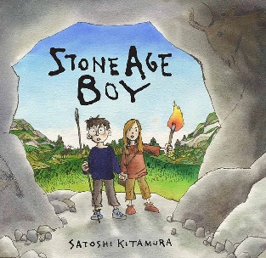
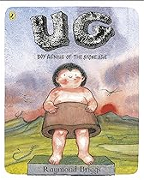
Stone Age Knowledge Organiser Y3-4 Term 1
Links to Other Subjects
Art Create replica historical objects using appropriate materials Science Extinction – recognise that environments can sometimes change and that his can sometimes pose dangers to living things
Key Vocabulary
Stone age - the prehistoric cultural stage that was characterised by the creation and use of stone tools.
Paleolithic - The cultural period of the Stone Age that began about 2.5 to 2 million years ago, marked by the earliest use of tools made of chipped stone.
Megalithic - ancient large stones, sometimes forming a group or circle / the period when these were important.
Neolithic - the later part of the Stone Age, including ground/ polished stone weapons.
Semi-nomadic – people that maintained a semi-permanent residence for part of the year.
Key Knowledge
To research aspects of life in the Stone Age and consider the changes in Britain during the Stone Age. To describe events and periods of time using the words: BC, AD, century, ancient. To order the periods on a timeline and compare to other events known. To ask and answer questions about how things were different in the past and how aspects of life have changed over time. To use evidence to describe and explain Stone Age settlements and how they are similar or different in different time periods. To explore early hunter-gathers and their artistic work in cave art and progress to early settlers where decoration of artefacts became more prevalent. To consider local history in looking at the White Horse at Uffington.
Prior Learning | Preparing for the Future
Events beyond living memory. Use pictures and artefacts to say what was different in the past. Put a few events, photos or objects in order of when they happened. Order events and people, I have studied using a simple timeline. Suggest why people acted as they did. Ask questions to find out about people/events in the past | A study of an aspect or theme in British history that extends pupils’ chronological knowledge beyond 1066 - War and Peace. Decide whether a source of evidence is reliable to describe: houses and settlements, buildings and their uses, culture, religion and leisure, way of life for different people e.g. rich and poor Use dates and historical vocabulary when ordering and comparing events from the past. Draw timelines to show a range of information

