Slide 1
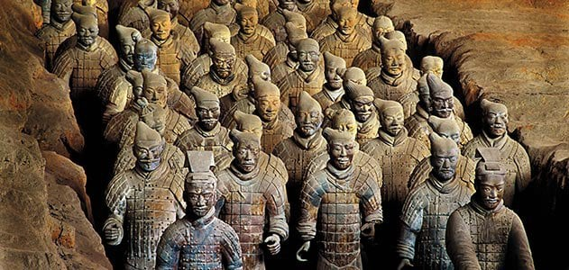


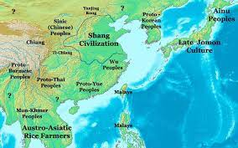
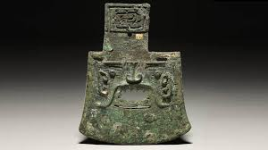
The Shang Dynasty Knowledge Organiser Y5-6 Term 6
Links to Other Subjects
Music: Words, Meaning and Expression: How does music shape our way of life? Identify and move to the pulse with ease. Think about the message of songs. Think about the historical context of songs. What else was going on at this time, musically and historically. Talk about music and how it makes you feel, using musical language to describe the music.
Key Vocabulary
Fu Hao – The first female military leader, who led 13,000 soldiers.
– shoulder bones of animals or turtle shells.
Dynasty – A sequence of rulers from the same family
Warlords – Often ruled areas of land but owed allegiance to the Emperor
Emperor – The ruler of a country
Pagoda – A religious temple that is built as a tower with many tiers and roofs.
Key Knowledge
1766 BC Shang Tang overthrows the existing Xia family leader, setting up his capital in Bo 1737 BC Tang’s son succeeds him after 29 years of rule 1700 - 1500 BC The Shang Dynasty usher in the use of bronze – weapons, tools and even chariots are made 1700 – 1000 BC Oracle bones are carved with characters to ask a question of the gods – China’s earliest form of writing 1700 – 1000 BC The Shang Dynasty create looms to make silk cloth, build palaces and have walled towns 1300 BC Emperor Pan Geng rules – Because of many enemies, he moves the capital city to Yin 1200 BC Emperor Wuding brings the dynasty to its peak – He is the 22nd ruler 1200 BC Lady Hao, a wife of Emperor Wuding, dies 1200 – 1046 BC The rulers after Wuding can’t hold the people together and the dynasty begins to decline 1046 BC Cruelty and high taxes cause the slaves to revolt and join forces with Chou people of West China.
Prior Learning | Preparing for the Future
The children will be able to describe and order periods in time using AD, BC and ancient, on a timeline. To understand that things were different in the past and have changed over time. To understand how artefacts help us to build a picture of how people lived in the past. | KS3: Know and understand significant aspects of the history of the wider world: the nature of ancient civilisations; the expansion and dissolution of empires.

