Slide 1
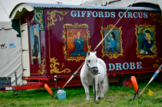
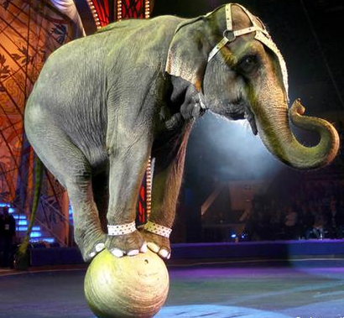
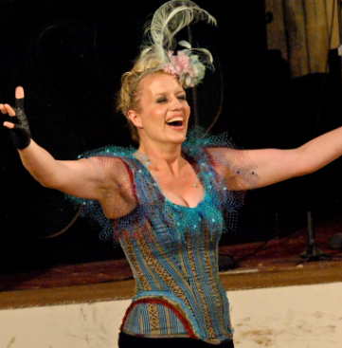
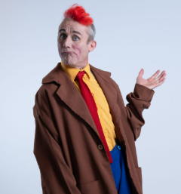
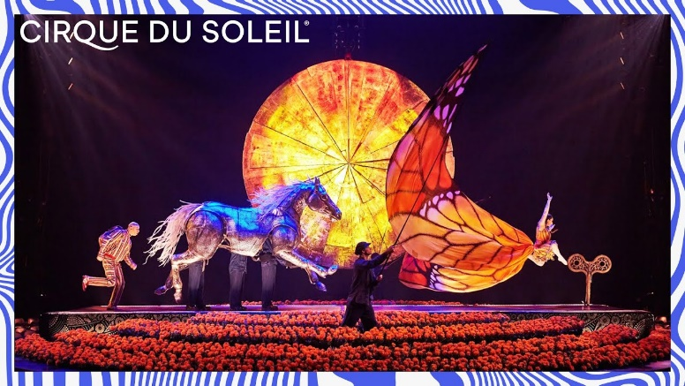
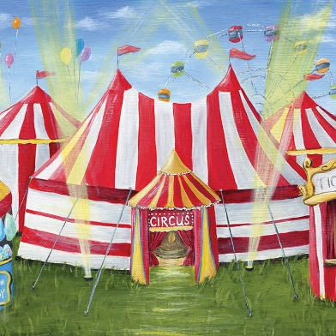
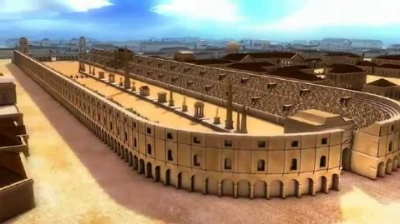
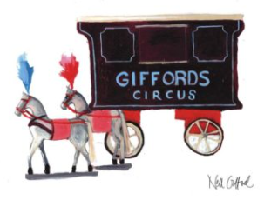
The Circus Knowledge Organiser Y1&2 Term 5
Key Knowledge
History The latin word circus comes from the Greek word kirkos meaning “circle“ or “ring”. The Circus has evolved from the chariot races that took place in Roman cities at the time of the Roman Empire. The first circus in Rome was the Circus Maximus The London Hippodrome was the first theatre designed for circus and variety performances. Modern circuses are travelling groups of clowns and acrobats that perform in large tents. The modern circus was developed by Philip Astley he displayed horse riding tricks in London in 1768 in an arena. During the late 18th and 19th centuries circuses took place in wooden circus buildings. Travelling circuses became popular in the US in the 19th century. Circuses were often moved by rail. Today they travel in large vehicles. In the 20th century the focus of circus acts shifted from animals to people, acrobats and gymnasts became the more popular acts. Circuses are now popular all over the world.
Key Vocabulary
Acrobat: a person who can do physical acts that take balance and skill.
Circus: a show with clowns, acrobats, music and other acts that travels around and performs in a tent.
Circus Maximus: an ancient Roman chariot-racing stadium and entertainment venue in Rome, Italy.
Carnival: a fair that travels from place to place and offers rides, games and shows.
Entertainer: a person who entertains by performing, such as a musician or comedian.
Expressions: the act of telling or showing thoughts or feelings.
Illusion: a state of seeing, hearing or sensing things in a false way.
Mood: the way a person feels at a certain time.
Parade: a procession of people, marching bands or vehicles in front of spectators as part of a celebration or ceremony.
Ringmaster: the person who directs performances in a ring at a circus.
Tightrope: a thick rope or wire that is stretched tight and high above the ring. Acrobats perform on a tightrope at a Circus.
Oracy
We will be using our oracy skills to debate if animals should be used at the circus.
Prior Learning | Preparing for the Future
History Know events happened in the past a long time ago. Know some similarities and differences between things in the past and now, drawing on experiences. Understand the past through stories and books. | History Develop a chronologically secure knowledge and understanding of British, local and world history. Note connections, contrasts and trends over time and develop the appropriate use of historical terms. Devise historically valid questions about change, cause, similarity and difference, and significance.

