Slide 1
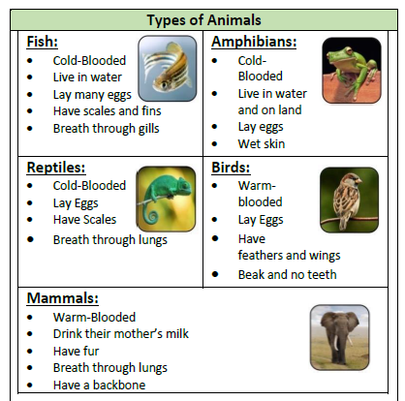
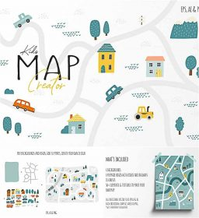
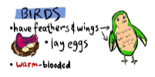
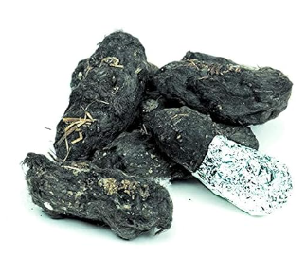
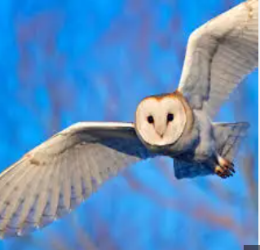
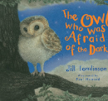
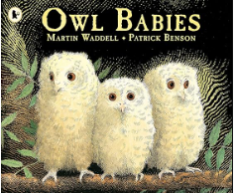
Owls Knowledge Organiser Y1&2 Term 2
Key Knowledge
Science Identify and name a variety of common animals that are carnivores, herbivores and omnivores and know what each type eats. Understand what a nocturnal animal is and be able to name some. Understand what habitat means. By dissecting Owl pellets understand what owls eat and be able to create a simple Food Chain. Be able to name different sources of light (The sun, fire, light bulbs, lightning, fire) Geography Know an Ordnance Survey map is used to help people find their way around an area. Be able to name features of our local area and identify where owls might live. Be able to list places of interest in our village. Be able to describe seasonal and daily weather patterns in the United Kingdom. Be able to read the temperature and record.
Key Vocabulary
Science
Habitat the natural environment of an animal or plant.
Skeleton the bones of the animal that gives it it’s shape.
Food Chain is a diagram that shows us how animals are linked by what they eat and what eats them. Energy and nutrients are transferred around the food chain.
A consumer is a plant or animal that eats another plant or animal.
Nocturnal active at night.
Geography
Local Area the area where you live.
Map a drawing of an area shown from above.
Route how you get to somewhere.
Compass can be used to help find your way.
Symbols show what different things or places can be found in an area.
Prior Learning | Preparing for the Future
Science Name, describe, identify and draw familiar animals through observations. Show care and concern for living things. Observe how animals behave differently as the seasons change. Geography Explain what a map or globe can be used for and locate the United Kingdom. Use geographical vocabulary to describe physical and human features (mountain, sea, ocean, river, soil, farm, house, shop). ______________________________ | Science Identify that animals, including humans, need the right types and amount of nutrition, and that they cannot make their own food; they get nutrition from what they eat. Recognise that they need light in order to see things and that dark is the absence of light. Geography Use grid references, symbols and keys (including the use of Ordnance Survey maps) to build knowledge of the wider world. Sketch maps of human and physical features.

